Slide 1

Web scraping to gain company insights
22/05/2024

Slide 2
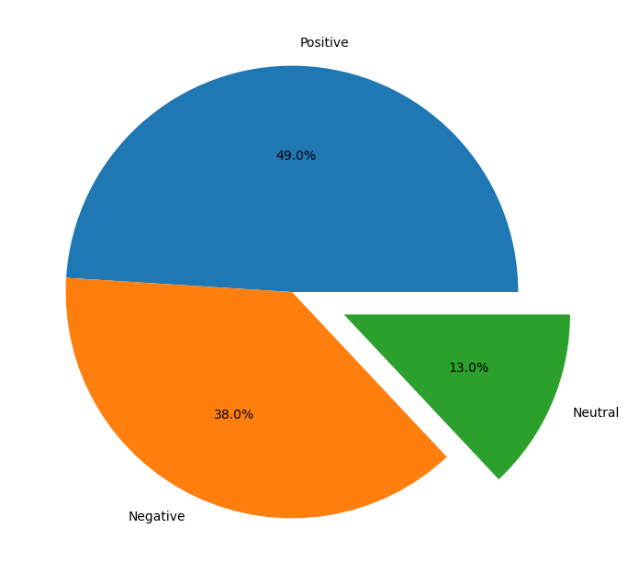
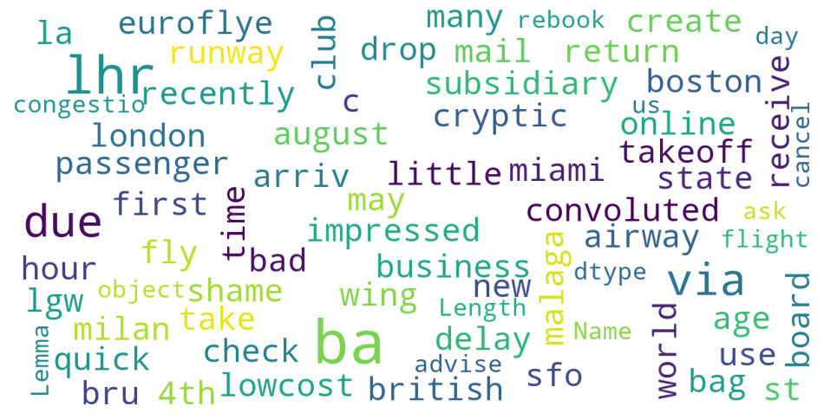
INSIGHTS FROM CUSTOMER REVIEWS
From cleaning 1500 reviews given by the customers, we obtained
Positive Reviews - 735
Negative Reviews - 570
Neutral Reviews – 195
Word cloud of keywords used in reviews

